Slide 1

Wall-Following Robot Project

Slide 2

Background
The project aims to design and implement a wall-following robot that can autonomously navigate along walls using sensors and actuators.

Slide 3
PROJECT METHODOLOGY
STEP ONE: LEARNING RESOURCES
The beginning mainly comprised of compiling online resources via youtube, wikipedia, and various online forums and gathering information about ultrasonic sensors and Arduino interface.
STEP TWO: BRAINSTORMING
This step included collaborating among ourselves to generate ideas for the project and discussing the different ways to mount the ultrasonic sensor on the chassis, and to discuss other creative leads.
STEP THREE: COMPONENT RESEARCH
The next step was researching the components we would need for the project, primarily Arduino uno including a motor driver L298N and ultrasonic sensors.

Slide 4
STEP FOUR: ARDUINO IDE
This goal was to gain proficiency over the Arduino IDE, which is crucial for programming our board.
STEP FIVE: TINKERCAD
Next we, utilise the service of Tinkercad for virtual circuit simulations test and identify any potential problems before building the physical prototype.
STEP SIX: IMPLEMENTATION
Once prepared to move forward with the physical implementation phase, we will be assembling the circuit, programming the Arduino board, and testing the system properly.
STEP SEVEN: CONCLUSION AND PRESENTATION
Done with the implementation, there could be further creative ventures to look into to improve our project further.
The final step of our project work would include properly presenting the documented progress using circuit diagrams, code snippets and proper explanations. This would then conclude the project successfully

Slide 5
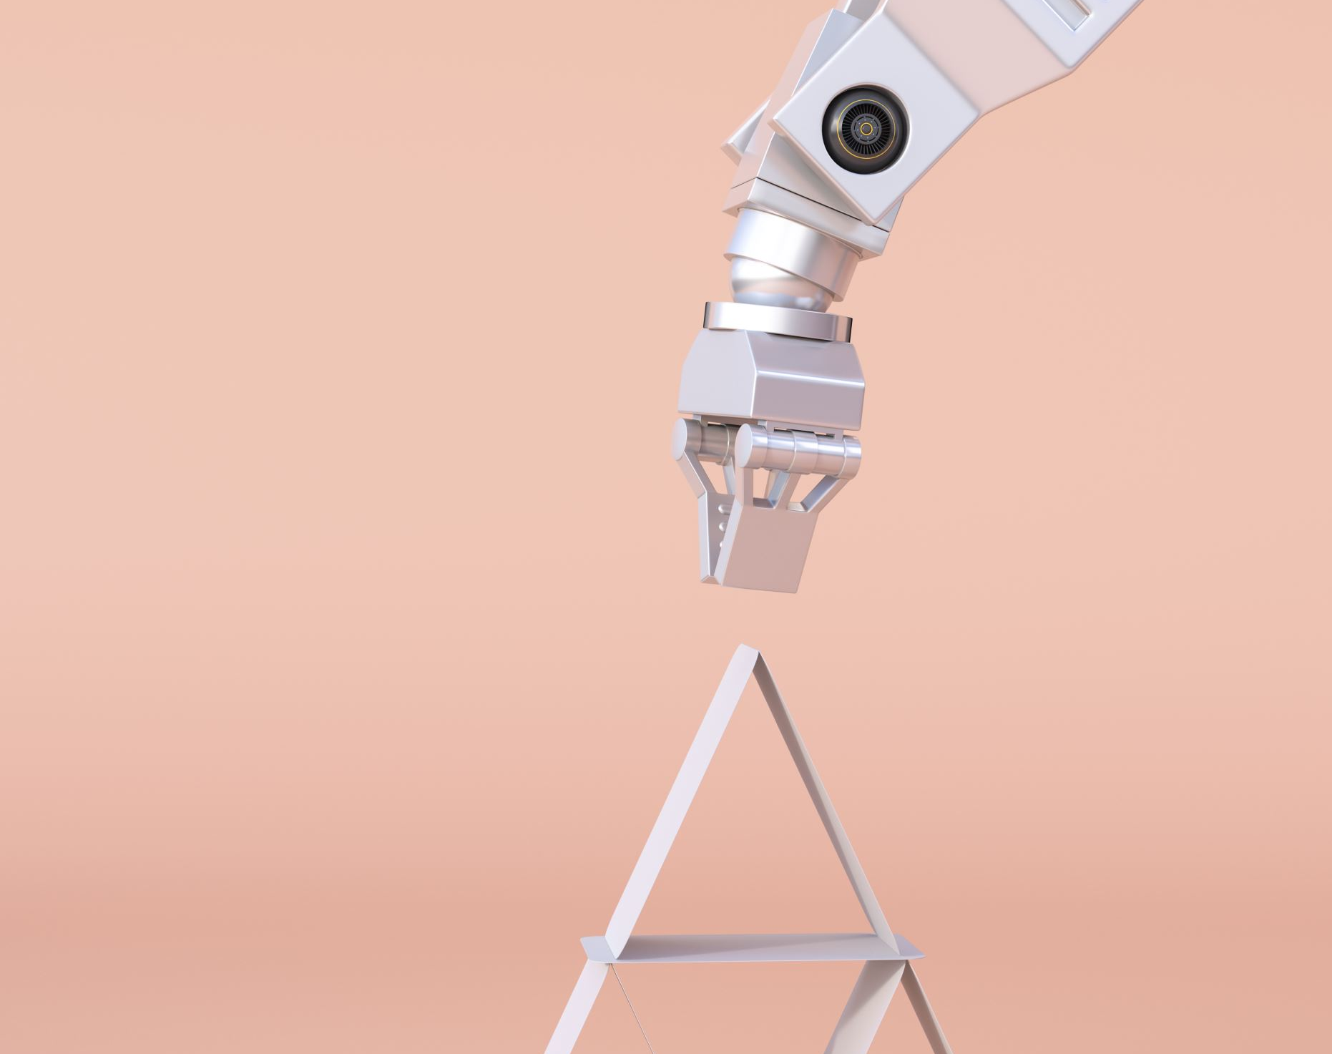
Design
The robot is equipped with ultrasonic sensors to detect distances from the walls. It utilizes a PID controller for precise control and has differential drive motors for maneuvering.

Slide 6
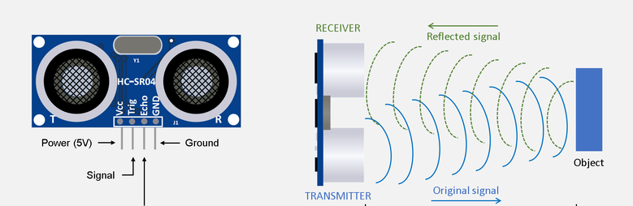
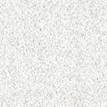
Sensors
The ultrasonic sensors are mounted on the front and on the sides of the robot to measure distances to obstacles, allowing the robot to maintain a consistent distance from the wall.
This Photo by Unknown Author is licensed under CC BY-SA-NC

Slide 7
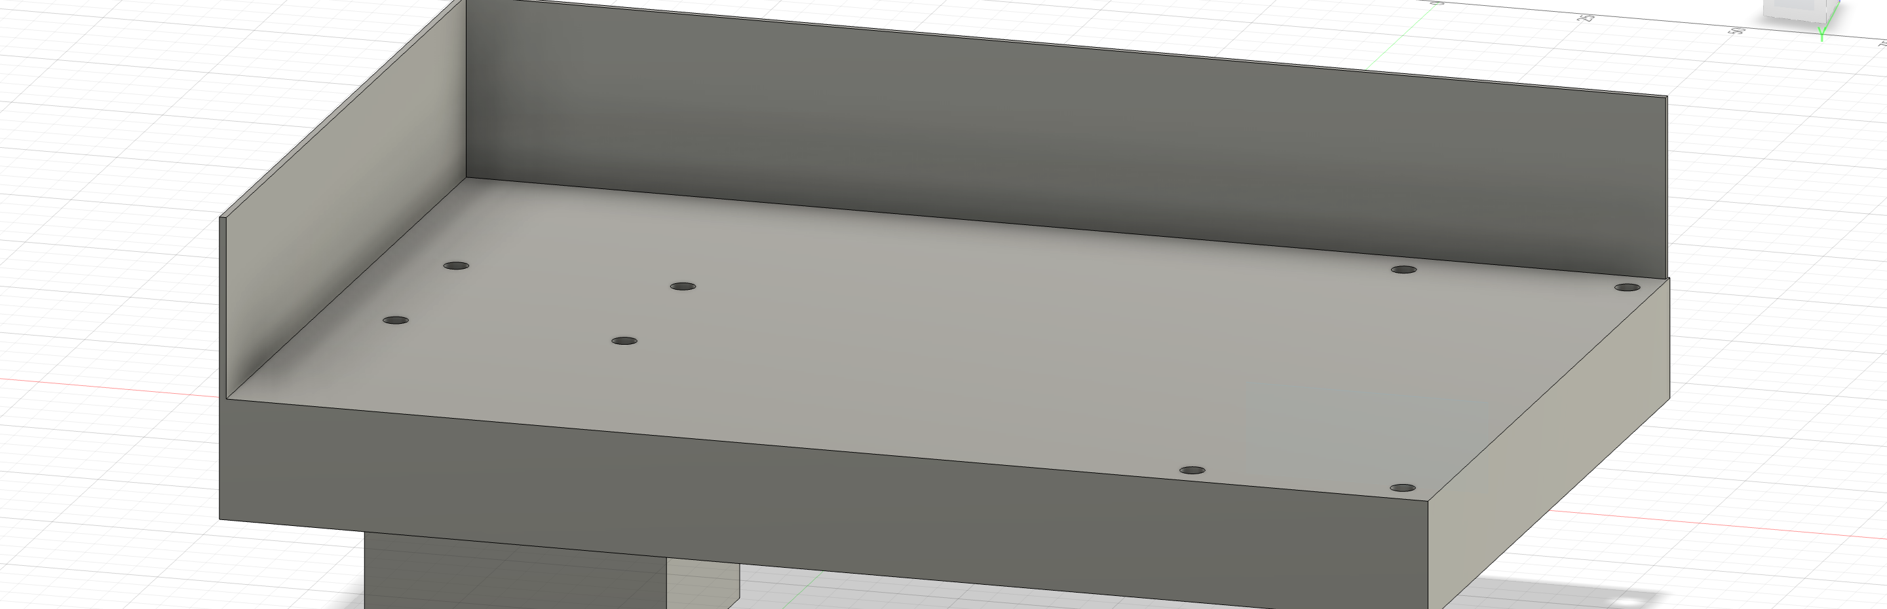
The 3D design of chassis made in fusion 360 .

Slide 8

Control System
The PID controller processes sensor data and adjusts motor speeds accordingly to keep the robot parallel to the wall.

Slide 9
PID Controllers and Their Working
PID controllers are used in control systems to regulate processes by continuously calculating an error value as the difference between a desired setpoint and a measured process variable. The controller attempts to minimize the error by adjusting the control input.
Working of PID Controller:
1. Proportional (P) Control: The controller output is proportional to the current error value. It provides an immediate response to the error.
2. Integral (I) Control: The controller output is proportional to both the magnitude and duration of the error. It eliminates any steady-state error.
3. Derivative (D) Control: The controller output is proportional to the rate of change of the error. It helps anticipate future error changes.
These three components are combined to adjust the control effort and stabilize the system.

Slide 10

Challenges & Solutions
Some challenges encountered during the project include tuning the PID parameters, dealing with sensor noise, and ensuring smooth motor control. And also we faced challenges with design of robot to balance the weights of the components on chassis for a balanced output.

Slide 11

Implementation
The robot was implemented using an Arduino microcontroller, L298N motor driver, and a 3D-printed chassis. The code was developed in Arduino IDE.

Slide 12
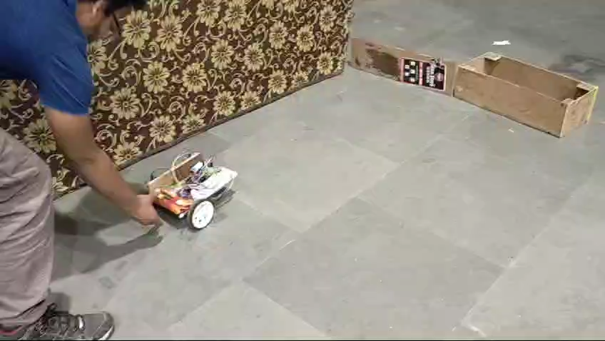
One of the videos of our working model after the implementation

Slide 13

Conclusion
In conclusion, the wall-following robot project demonstrates the application of sensor-based control systems in autonomous robotics. Future work may include adding obstacle avoidance capabilities and optimizing the robot's performance.

